Slide 1

African Swine Fever
NPPC Webinar
August 29, 2018
Dr. Harry Snelson
American Association of Swine Veterinarians

Slide 2
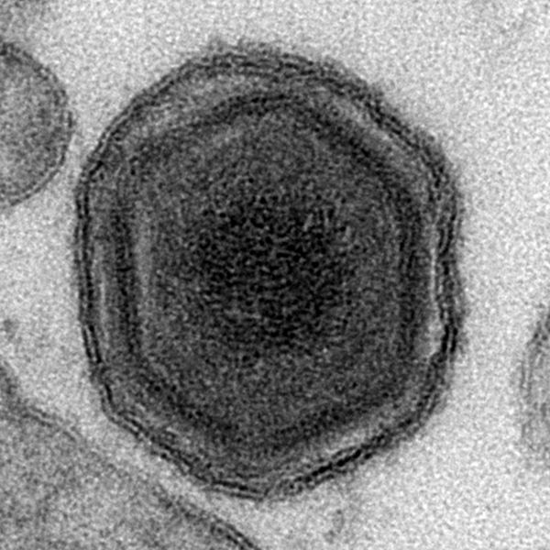
African Swine Fever Virus
Highly contagious
viral disease of swine
Does not affect humans
Asfarviridae
  Enveloped DNA virus
  Transmitted by arthropods
Isolates vary in virulence
  High virulence: up to 100% mortality
  Low virulence: seroconversion
Notes:
2
African swine fever (ASF) is a highly contagious viral disease of swine. The disease is caused by the African swine fever virus (ASFV). This virus is the sole member of the new genus Asfivirus (Family: Asfarviridae) and was formerly classified as a member of the family Iridoviridae. ASFV (shown here) is a large, lipoprotein-enveloped, icosahedral, double-stranded DNA virus. The virus is the only known DNA virus that is transmitted by arthropods. The virus replicates in Ornithodoros ticks and can be transmitted to swine through the bite of the tick. ASFV isolates vary greatly in their virulence, with highly virulent isolates causing up to 100% mortality, and lower virulent isolates leading only to seroconversion.
[This photo shows an transmission electron microscopy (TEM) electromicrograph of the African swine fever virus. Source: Institute for Animal Health via commons.wikimedia.org].

Slide 3
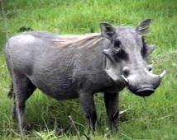
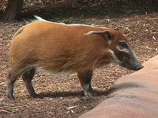
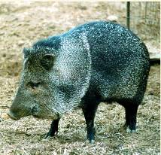
African Swine Fever Virus
Highly resistant
  At least 30 days in pens
  >140 days in some
  pork products
  Years in frozen carcasses
Killed by high temps
and some disinfectants
Affects domestic and
wild pigs – Warthogs are a natural host
warthog
bush pig
collared peccary
Notes:
3
ASFV is highly resistant in the environment and can survive for 1 to 1/2 years in blood stored at 4ºC (39ºF), 11 days in feces at room temperature, and at least a month in contaminated pig pens. The virus will also remain infectious for 150 days in boned meat stored at 3.9ºC (39ºF), 140 days in salted dried hams, and several years in frozen carcasses. ASF affects domestic pigs and wild pigs, including the warthog, bush pig, giant forest hog in Africa, and the feral pig in Europe. The collared peccary (Tayassu tajacu) and the white-lipped peccary (Tayassu albirostris) of the Americas may be able to carry the virus asymptomatically.
[Photos: Top: Warthog (Source: George Mason University-mason.gmu.edu); Middle: bush pig (from http://www.rth.org/sdzoo/Western%20bush%20pig.jpg); Bottom: collared peccary (from http://www.scz.org/animals/p/pic/peccary2.jpg)*] *Link defunct as of 12/13/2010.

Slide 4
Morbidity/Mortality
Morbidity approaches 100%
  Previously unexposed herds
Mortality varies with virulence
of isolate
  Ranges from 0 to 100%
May be asymptomatic in wild pigs or Warthogs
No treatment or vaccine
Notes:
4
In domestic pigs, the morbidity (illness) rate approaches 100% in naive herds. Mortality (death) varies with the virulence of the isolate, and can range from 0 to 100%. Factors that can increase mortality from less virulent isolates include concurrent disease, young age, and pregnancy. Mild or asymptomatic disease is usually seen in warthogs and bush pigs. No treatment or vaccine currently exists for this disease.

Slide 5
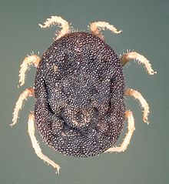
Animal Transmission
Direct contact
  Usually oronasal
Indirect
  Uncooked garbage
  Fomites
  Bite of infected ticks
  Mechanically by biting flies
Found in all tissues and body fluids
Notes:
5
The primary method of ASF spread from country to country has been through the feeding of uncooked garbage containing ASFV-infected pork scraps. A pig can also become infected with ASFV by direct contact with infected animals (usually by oronasal spread) or indirect contact via contaminated people, equipment, vehicles, and feed. Aerosol transmission is thought to be unimportant, and only seems to occur over short distances when pigs are in close contact. Pigs that recover may become carriers of the virus for several months. ASFV is also spread through the bite of infected Ornithodoros erraticus or O. moubata (pictured) soft ticks. Other bloodsucking insects, such as mosquitoes and biting flies, may transmit the virus mechanically. ASFV can be found in all tissues and body fluids, with particularly high levels in blood.
[The photo shows an adult Ornithodoros soft tick. Source: commons.wikimedia.org]

Slide 6
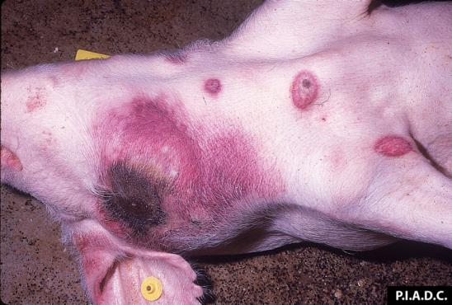
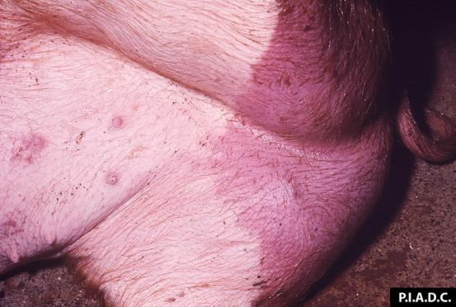
Clinical Signs:
Acute Disease
Incubation period:
<5 to 19 days
Clinical signs
  High fever
  Moderate anorexia
  Erythema, cyanosis
  Recumbency
  Bloody diarrhea
  Abortion
  Death
Notes:
6
The incubation period of ASF is 5 to 19 days following direct contact with infected pigs, but can be less than 5 days after exposure to infected ticks. More virulent isolates of ASFV cause a high fever, moderate anorexia, leukopenia, recumbency, and erythema that is most apparent in white pigs (top photo). Cyanotic skin blotching on the ears, tail, lower legs, or hams may also develop. Diarrhea may be mucoid or hemorrhagic (bottom photo). Abortions are frequently seen in pregnant sows. Pigs may also experience dyspnea, vomiting, and nasal and conjunctival discharges; however, most pigs infected with ASFV remain in good condition. With highly virulent isolates, progressive anorexia and depression develop and are usually followed by death within 10 days. Peracute disease is characterized by sudden death with few lesions, and may be the first sign of an infection in a herd.
[These photos show acute clinical signs seen with African Swine Fever virus infection. Top: Multiple sharply demarcated foci of cutaneous hemorrhage and/or necrosis. Bottom: There is a large sharply demarcated zone of hyperemia on the perineal skin of this pig. Source: Plum Island Animal Disease Center]

Slide 7
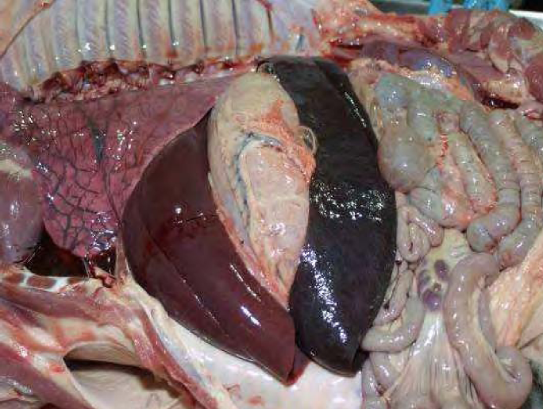
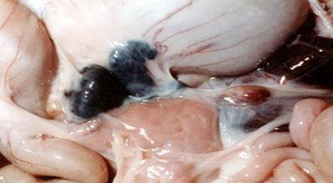
Post Mortem Lesions:
Most Common
Hemorrhagic
  Spleen
    Enlarged
    Friable
    Dark red, black
  Lymph nodes
  Kidneys
  Heart
Notes:
7
The gross lesions of African swine fever are highly variable. The most consistent and characteristic post mortem lesions occur in the spleen and lymph nodes. With highly virulent infections, the spleen is usually enlarged, friable, and dark red or black (top photo). With moderately virulent infections, the spleen is enlarged but not friable, with a nearly normal color. Lymph nodes may be swollen and hemorrhagic, with the most commonly affected lymph nodes being the gastrohepatic (bottom photo), renal, and mesenteric. The tonsils may also be swollen or reddened.
[These photos show post mortem lesions caused by African swine fever virus. Top: A greatly enlarged dark red to black spleen. Bottom: A very enlarged dark red (hemorrhagic) gastrohepatic lymph nodes. Source: Foreign animal Diseases: The Gray Book from www.aphis.usda.gov/emergency_response/downloads/nahems/fad.pdf‎]

Slide 8
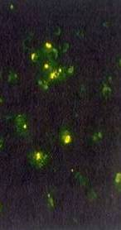
Diagnosis
Suspect ASF in pigs with:
  Fever
  Characteristic post mortem
  signs in spleen, lymph nodes
Laboratory tests
  Virus isolation
  Viral antibody detection
  PCR
Notes:
8
ASF should be suspected in pigs with a fever and when necropsy findings include an enlarged, friable, dark red or black spleen and extremely enlarged and hemorrhagic lymph nodes. In areas where ASF is not endemic, the disease should be diagnosed by virus isolation, detection of viral antibodies by the fluorescent antibody test (shown above), and PCR. For virus isolation, blood and tissue samples (such as spleen, lymph nodes, lung) from suspect pigs are inoculated into pig leukocyte or bone marrow cultures. For the fluorescent antibody test, ASFV antigens are detected in tissue smears or cryostat sections. Nucleic acids can be detected by the PCR assay (which is particularly useful in putrefied samples that can’t be used for virus isolation). A rapid, real time PCR technique using tonsil scraping samples has been described; this test can detect the virus a few days before the onset of symptoms.
[This photo shows a positive fluorescent antibody (FA) test. The ASF antigen is indicated by bright green fluorescence when examined with a special fluorescence microscope. Source: Food and Agriculture Organization of the United Nations (FAO): Recognizing African swine Fever: A field manual at http://www.fao.org/docrep/004/x8060e/x8060e00.htm]

Slide 9
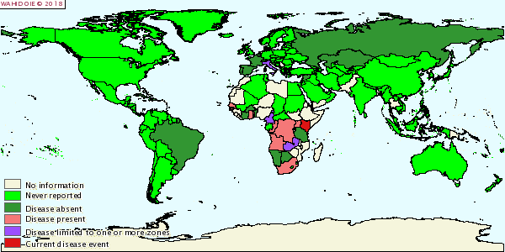
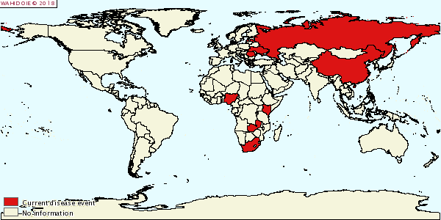
History
Discovery
  Kenya, early1900s
Confined to sub-Saharan Africa and Sardinia until 2007
Recent outbreaks
  The Caucasus (Georgia) in 2007
  Spread to Russia, Lithuania, Latvia, Poland, Romania, China
2006
2018
Notes:
9
African swine fever, as its name implies, is endemic in Africa (particularly the southern portion). There, the virus exists in wild African swine. ASFV was discovered in the early 1900s in domesticated swine in Kenya. In 1957, the virus spread outside of Africa to Europe (specifically, Portugal). The outbreak was successfully eradicated, but soon after outbreaks of the disease occurred in additional European countries; since the 1960s outbreaks have occurred in Italy, Spain, Malta, Sardinia, Belgium, and the Netherlands. By the mid-1990s, the disease was eradicated from Europe except for feral swine on the Island of Sardinia.
In 1963, Spanish workers isolated ASFV from the soft tick Ornithodoros erraticus collected from ASF-infected farms. Researchers showed that the virus replicates inside the ticks and can be transferred between other species. Individual ticks can apparently remain infected for life, and infected soft tick colonies maintain the virus for years. Some researchers believe that ASFV is actually a tick virus, and that the pig is an accidental host.
In 1971, ASF first appeared in the Western Hemisphere in Cuba. The disease was eradicated following the death or depopulation of over 400,000 pigs. In the late 1970s, ASF outbreaks occurred in Brazil, the Dominican Republic, Haiti and again in Cuba. The disease has been successfully eradicated from the Western Hemisphere by depopulation measures, and ASF has never occurred in the United States. In April 2007, several outbreaks of ASF were reported in the country of Georgia (Europe); the source of the virus is unknown but thought to have come from imported frozen or processed pig meat. Since then, ongoing outbreaks have been documented in the Caucasus and Africa.
[Photo: This photo shows outbreak sites of ASF in the country of Georgia in 2007. Source: World Organization of Animal Health – World Animal Health Information Database (WAHID) at http://www.oie.int/wahid-prod/public.php?page=disease_outbreak_map]

Slide 10
Spread to China
>20 reported cases
  1st case early August
  Appears likely to have been in the country since march or April
Widely dispersed
Route of introduction not confirmed – Russian pigs?
100% homologous to current strains
ASF genetic material found in processed sausages in Korea
Timeline
3/24 – Wang buys 100 pigs
April – pigs become sick and some die
7/5 -- Wang sells 45 pigs to Zhang
8/3 – ASF confirmed on Zhang farm

Slide 11
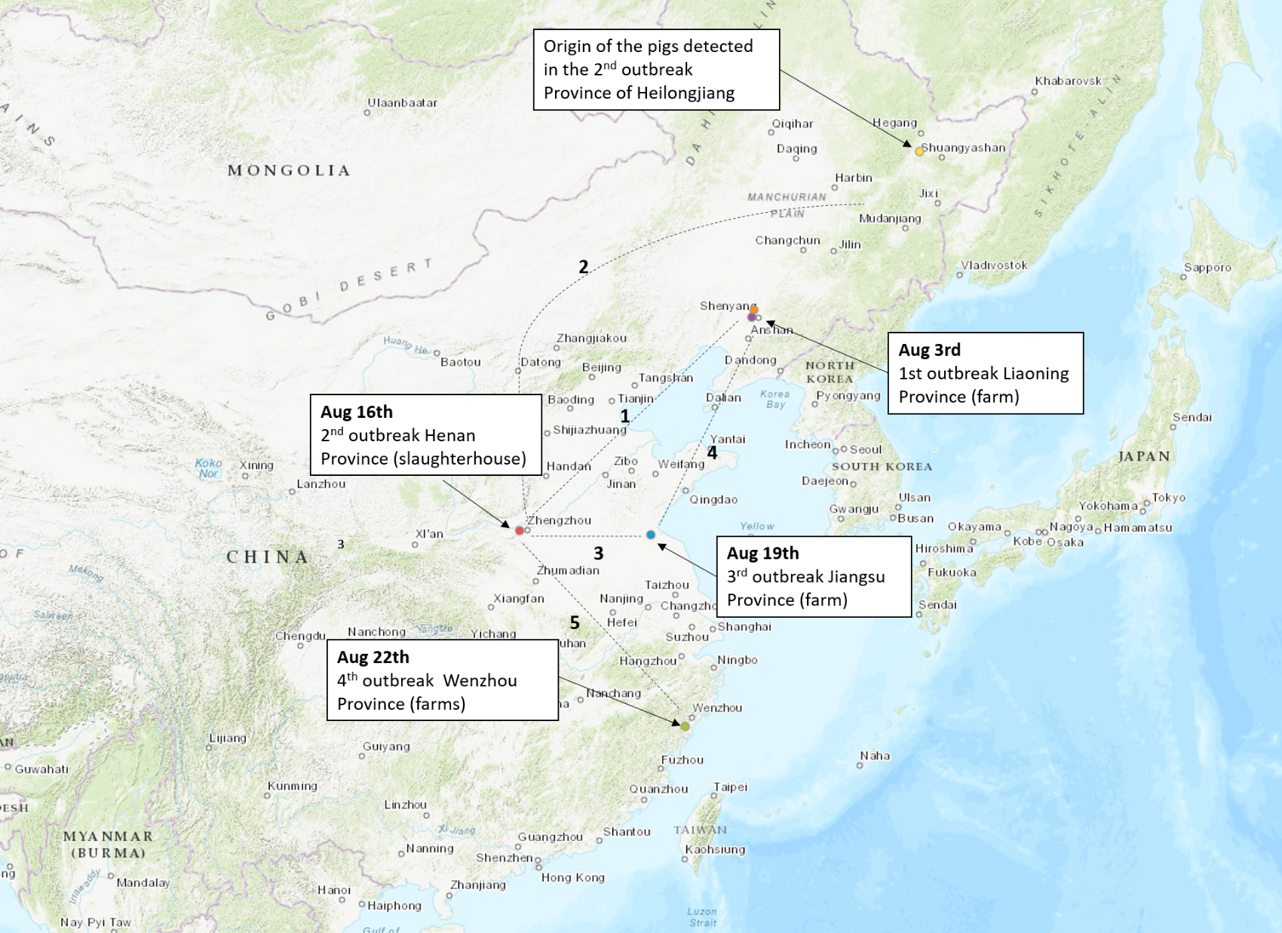
Mar 23
100 pigs sold to Wang Farm
Distances by road from different points: 1: = 870 miles (1,400 km); 2= 1,400 miles (2,253 km); 3: 350 miles (563 km); 4: 800 miles (1,288 km); 5: 500 miles (800km).

Slide 12
Why are we concerned?
China’s the largest pork producer in the world
Lots of people traffic and ingredient imports
History of disease transmission from Asia to the U.S.

Slide 13
Resources
AASV
https://www.aasv.org/aasv%20website/Resources/Diseases/ForeignAnimalDiseases.php
Pork Checkoff
https://mailchi.mp/pork/fad-preparation-bulletin-aug-24-2018?e=e31e5f8919
Center for Food Security and Public Health
http://www.cfsph.iastate.edu/DiseaseInfo/disease.php?name=african-swine-fever&lang=en
USDA
https://www.aphis.usda.gov/animal_health/downloads/animal_diseases/swine/ed-notice-asf.pdf
OIE
http://www.oie.int/en/animal-health-in-the-world/animal-diseases/african-swine-fever/
Swine Health Information Center
https://www.swinehealth.org/

